Slide 1
Introduction to Computer Vision
8. Image descriptors.
28.11.22
Mikhail Belyaev

Slide 2
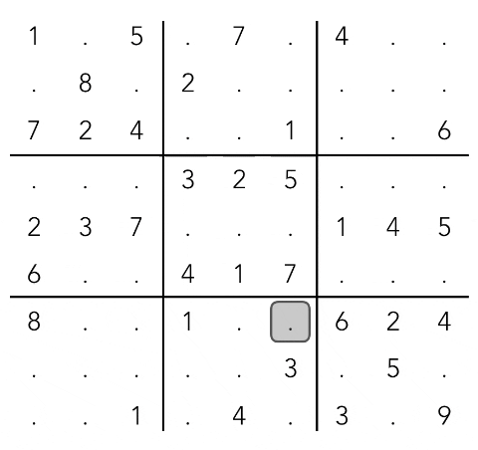
Homework 2: sudoku!

Slide 3
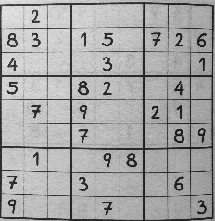
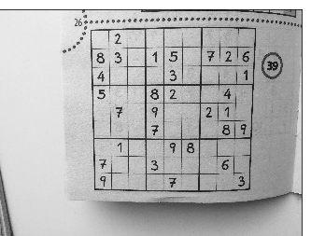
Part 1: Normalize the image

Slide 4
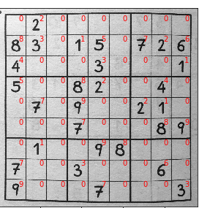
Part 2: Recognize digits

Slide 5
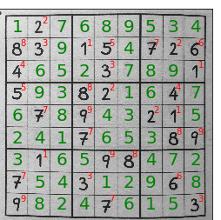
Part 3: solve sudoku

Slide 6
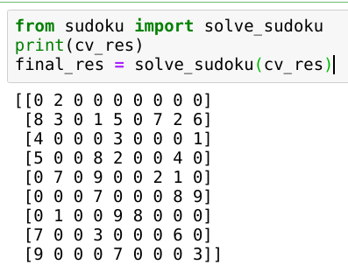
Part 3: solve sudoku

Slide 7
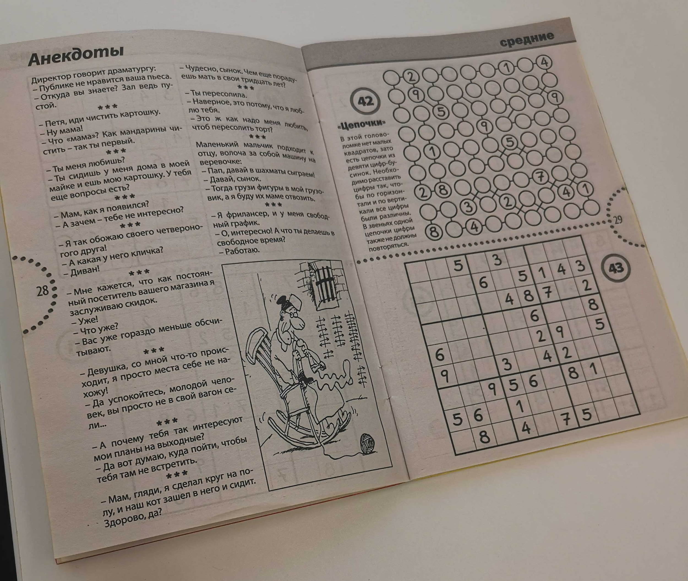
Identifying sudoku-ness

Slide 8
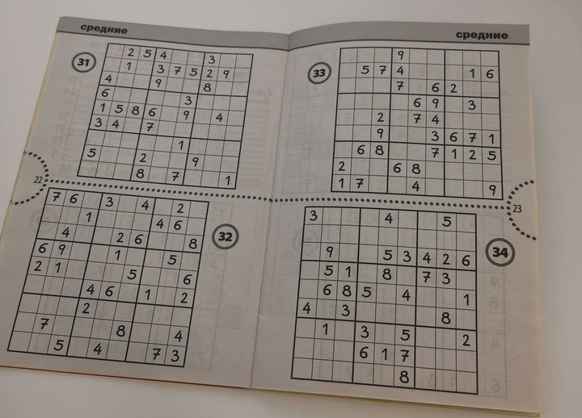
Identifying sudoku-ness

Slide 9
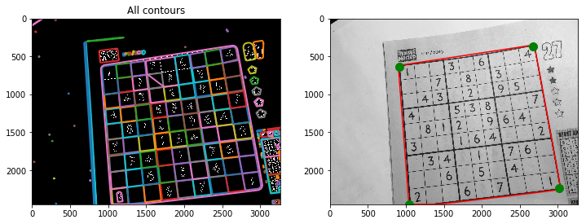
Identifying sudoku-ness

Slide 10
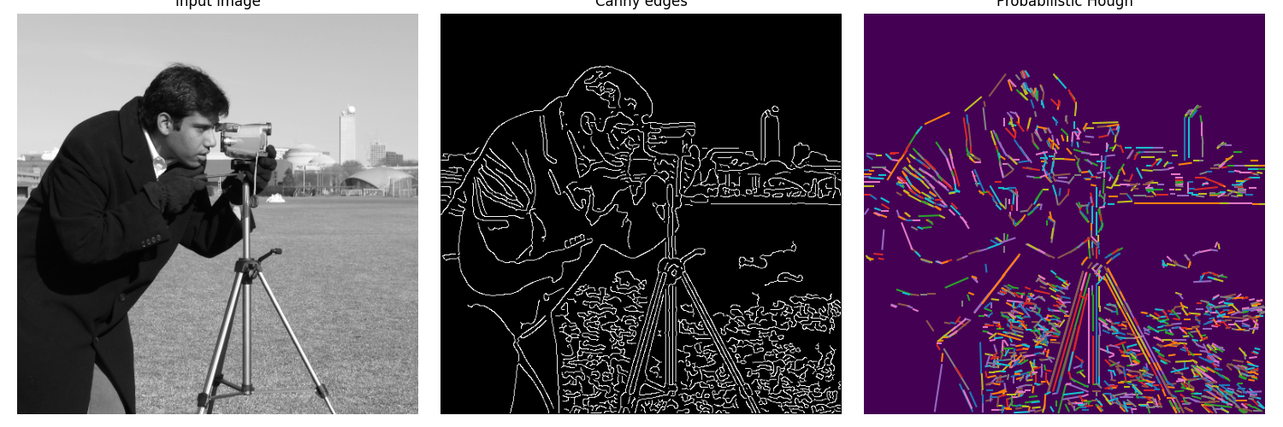
Probabilistic Hough
Hough transform allows you to identify lines, but usually you need intervals.
You can identify it manually (e.g. via intersection with edges)
Or you can use skimage probabilistic Hough
https://scikit-image.org/docs/dev/auto_examples/edges/plot_line_hough_transform.html

Slide 11
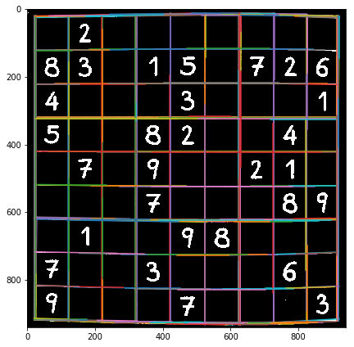
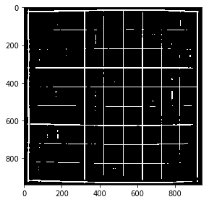
Identifying sudoku-ness
Probabilistic hough or template matching with large cross can be used to select a contour with sudoku

Slide 12
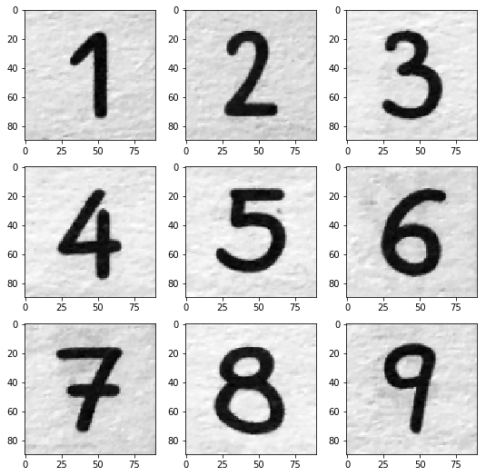
Recognize digits. Templates
Last year we used templates

Slide 13
Recognize digits. Templates
Last year we used templates
Issues: different fonts

Slide 14
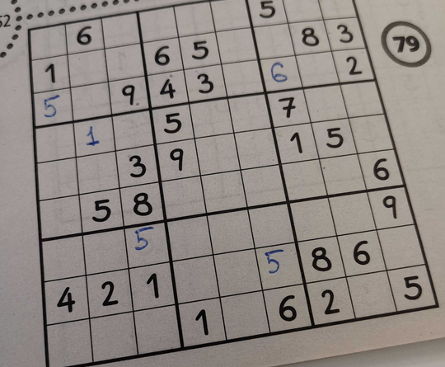
Recognize digits. Templates
Last year we used templates
Issues: different fonts

Slide 15
Recognize digits. Templates
Last year we used templates
Issues: different fonts
Solution: create a classifier using MNIST & HoG + SVC

Slide 16
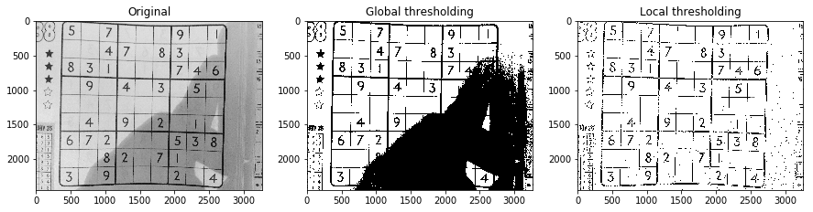
Image binarization
As we actually need a binary pattern, it may be a good idea to binarize the image. But it must done with care, see below

Slide 17
Objective
We want to extract features to know how different images relate to each other
Pipeline:
Detect keypoints for each image
Compute keypoints descriptors to match them
Aggregate matches over many keypoints for robust predictions

Slide 18
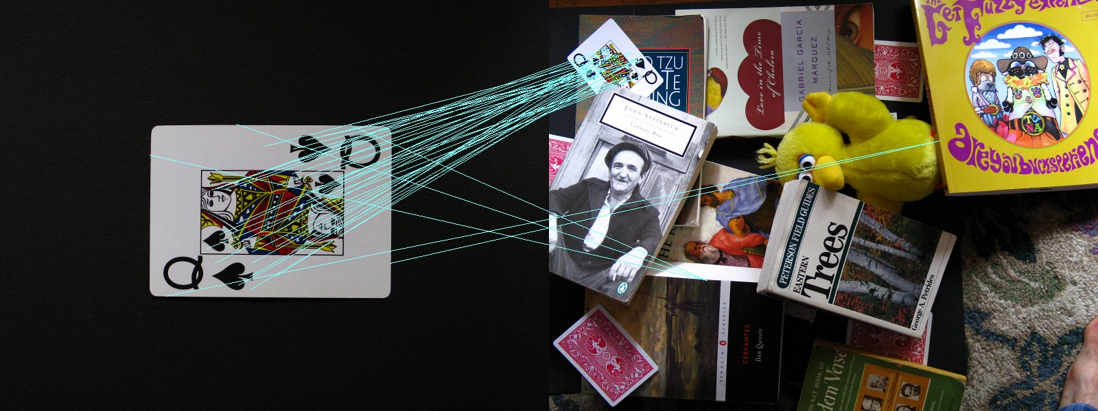
Applications. Old-school object recognition
For some kinds of objects it will work. (good keypoints, not very hard scene conditions)
For the yellow duck it less likely.
https://robwhess.github.io/opensift/

Slide 19
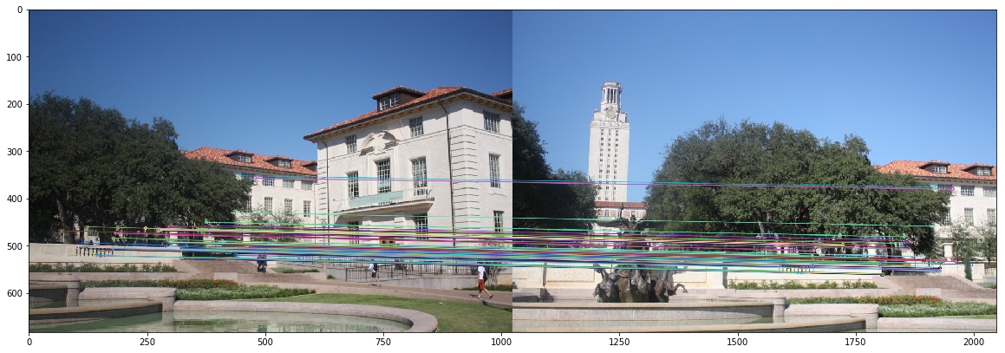
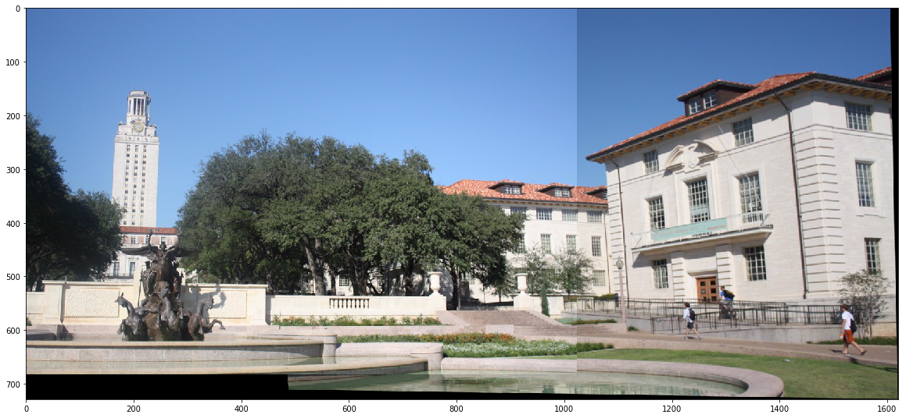
Applications. Image Stitching
In case of static images
it is possible to find a
suitable transformation
https://morioh.com/p/bd1b6fc9d9eb

Slide 20
Applications. Image Stitching
But a clear edge between pictures is visible, may be required additional steps

Slide 21
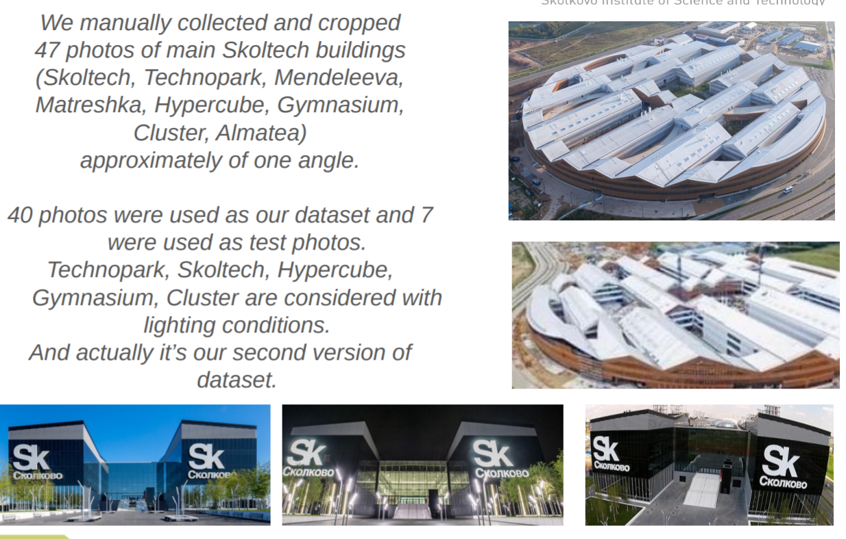
Applications. Image retrieval
Search over existing set of images!
Source: final project 2019 by Olga Novitskaia and Maria Begicheva

Slide 22
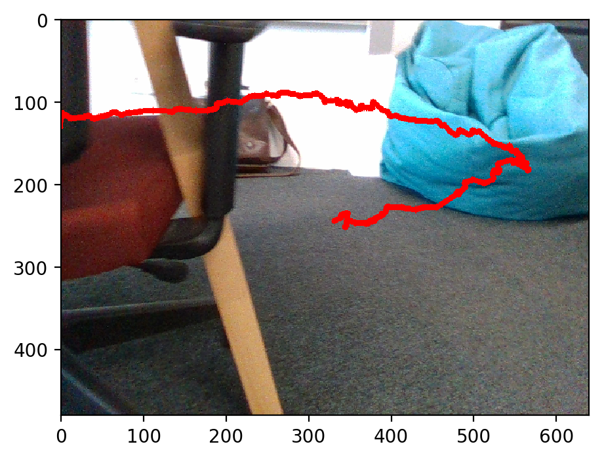
Applications. SLAM (Simultaneous localization and mapping)
As result - we can view the camera trajectory on the first image
(it is computed across many frames)
Source: homework from 2019

Slide 23
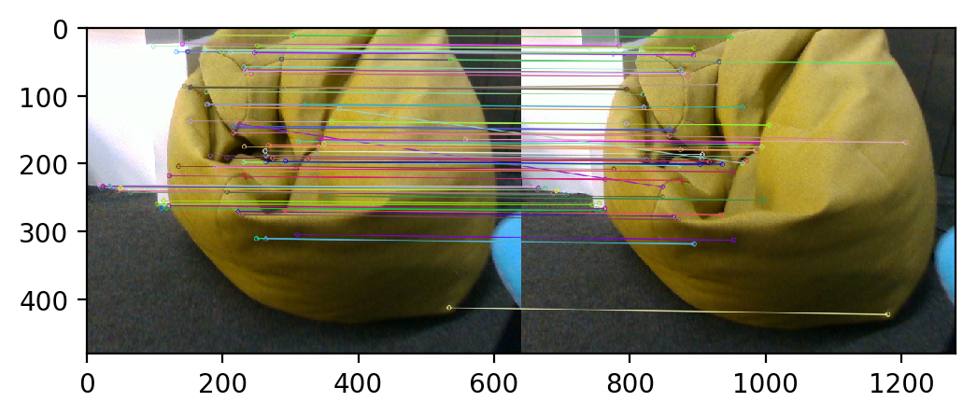
Applications. SLAM (Simultaneous localization and mapping)
A great application since robot positions change a little between frames => frames change not much => determine actual robot movement

Slide 24
Applications
Pros:
No required training
Easy to use
Cons:
Static images required (buildings, mountains, etc.)
No a priori knowledge about objects (their 3d shapes)
Better than template matching, but still not great robustness (elastic objects, hard lighting conditions etc.).

Slide 25
Required properties
Rotation invariant
Scale invariant
Robustness for changes in the light conditions
Keypoints detector has to produce points at the same points under this conditions.
Feature descriptors are also required to account for the same properties.

Slide 26
Solution
Convolve original image with some kernel (should have previous properties)
Find local extrema - they would be keypoints

Slide 27
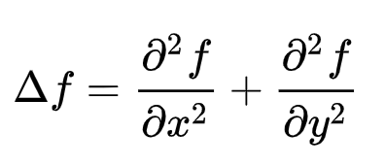
Solution
Convolve original image with some kernel (should have previous properties)
Find local extrema - they would be keypoints
Laplacian operator is known to be invariant under Euclidean transformations !

Slide 28
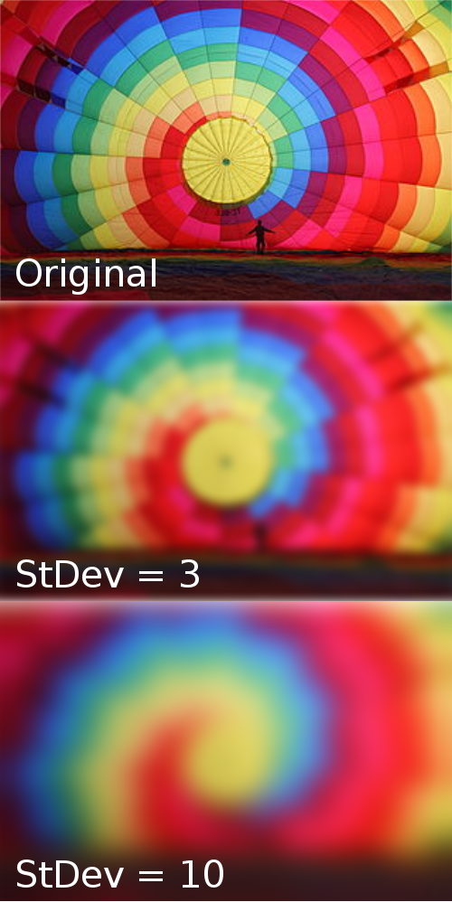
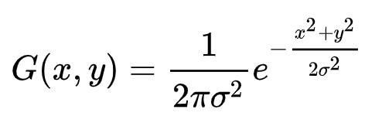
Fixing problems for laplacian
Derivatives of an image are very noisy.
Blur it with Gaussian

Slide 29
Fixing problems for laplacian
Derivatives of an image are very noisy.
Blur it with Gaussian!
It is not scale invariant.
Compute it for different sigma!
Notes:
( (kx)^2 + (ky)^2))/ sigma^2 = ( x^2 + y^2))/ sigma`^2

Slide 30
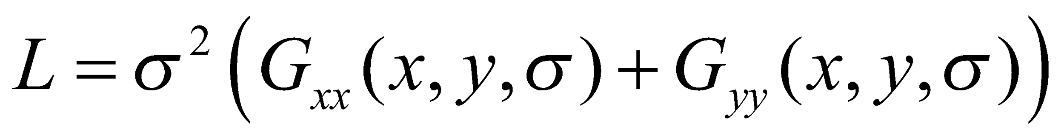
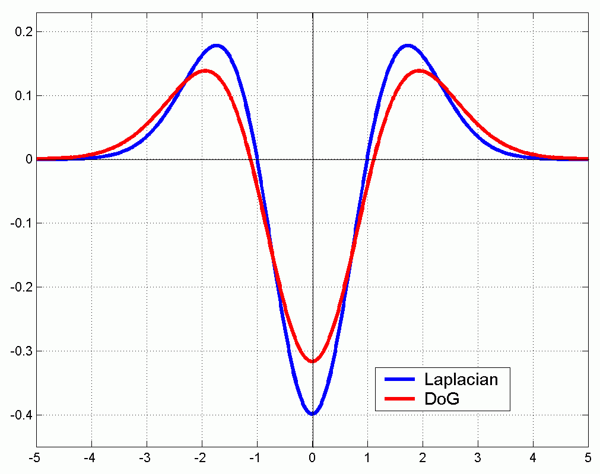

Fixing problems for laplacian
3. Second derivatives are computationally extensive
(Laplacian of Gaussians)
Let’s replace them with simple subtraction
(Difference of Gaussians)
Local extremums of laplacian remain in the same points

Slide 31
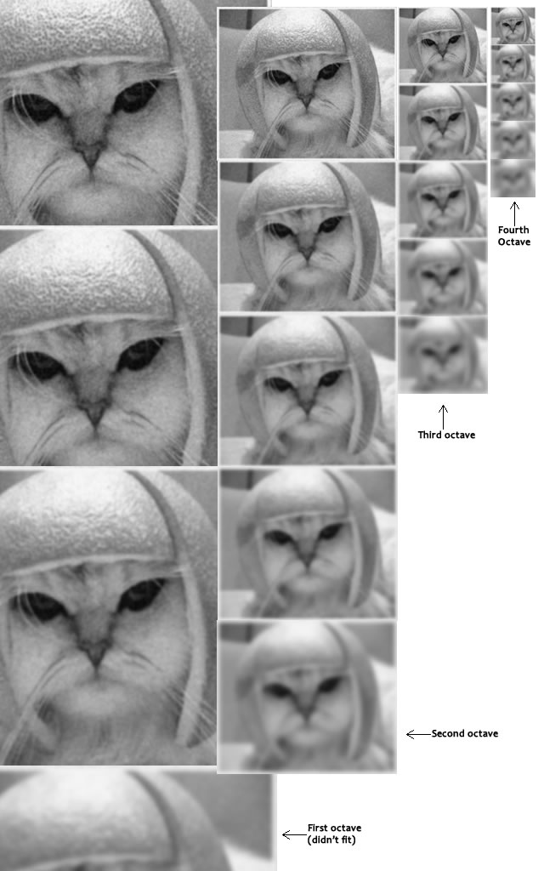
Making it scale invariant
Compute for different scales and gaussian sigma
The creator of SIFT suggests that 4 octaves and 5 blur levels are ideal for the algorithm.
Keypoints are extremums of DoG in this space

Slide 32
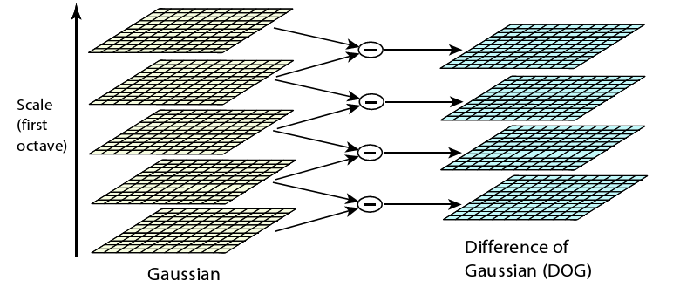
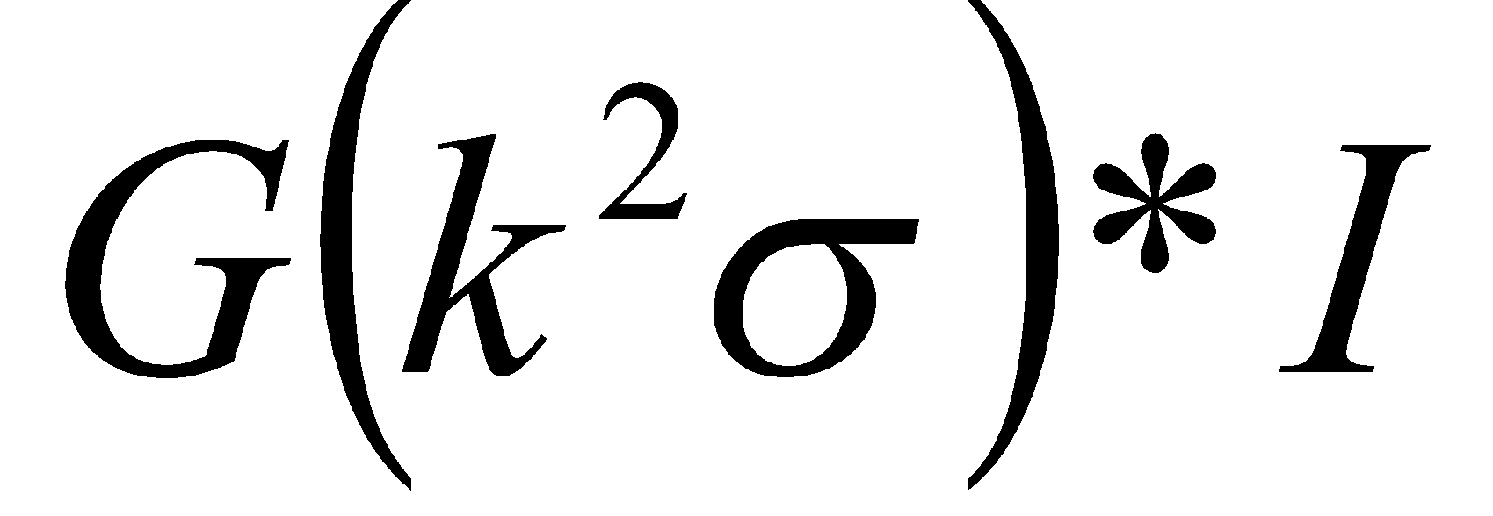
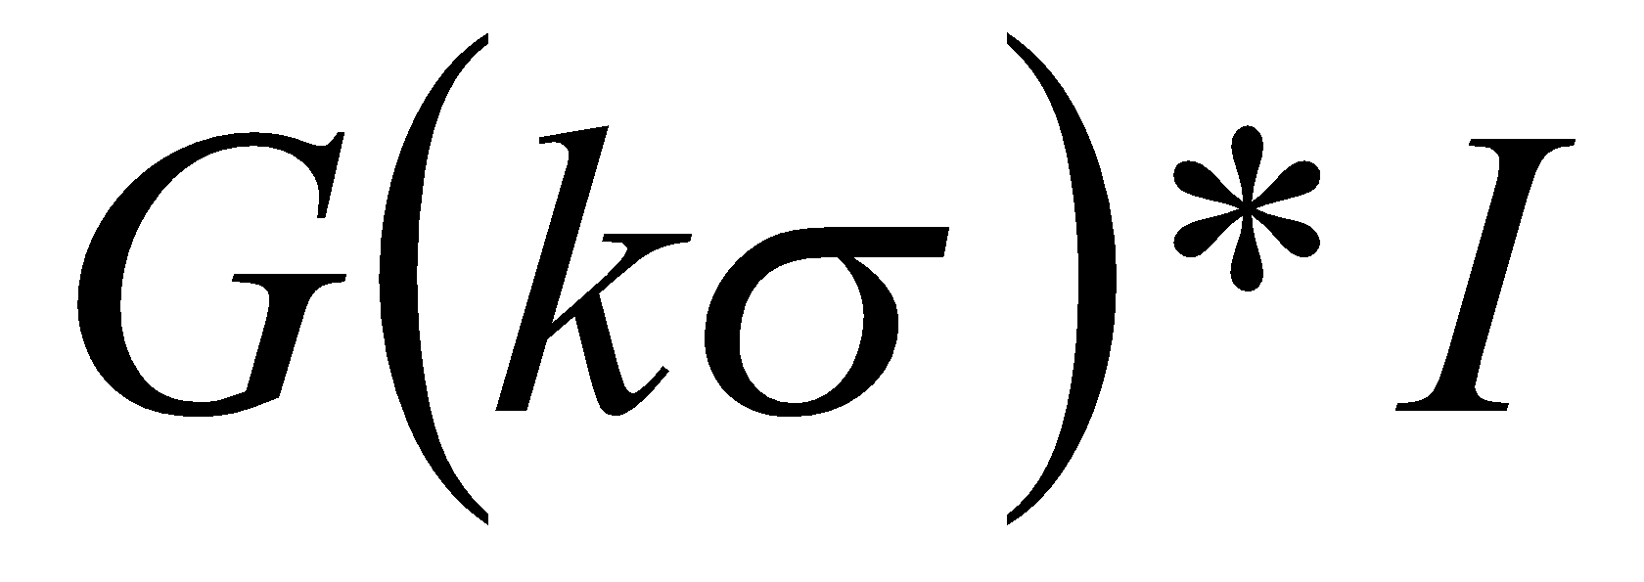
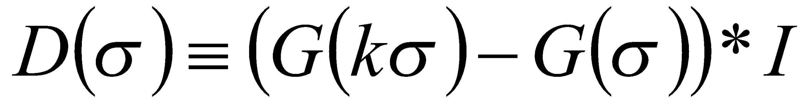
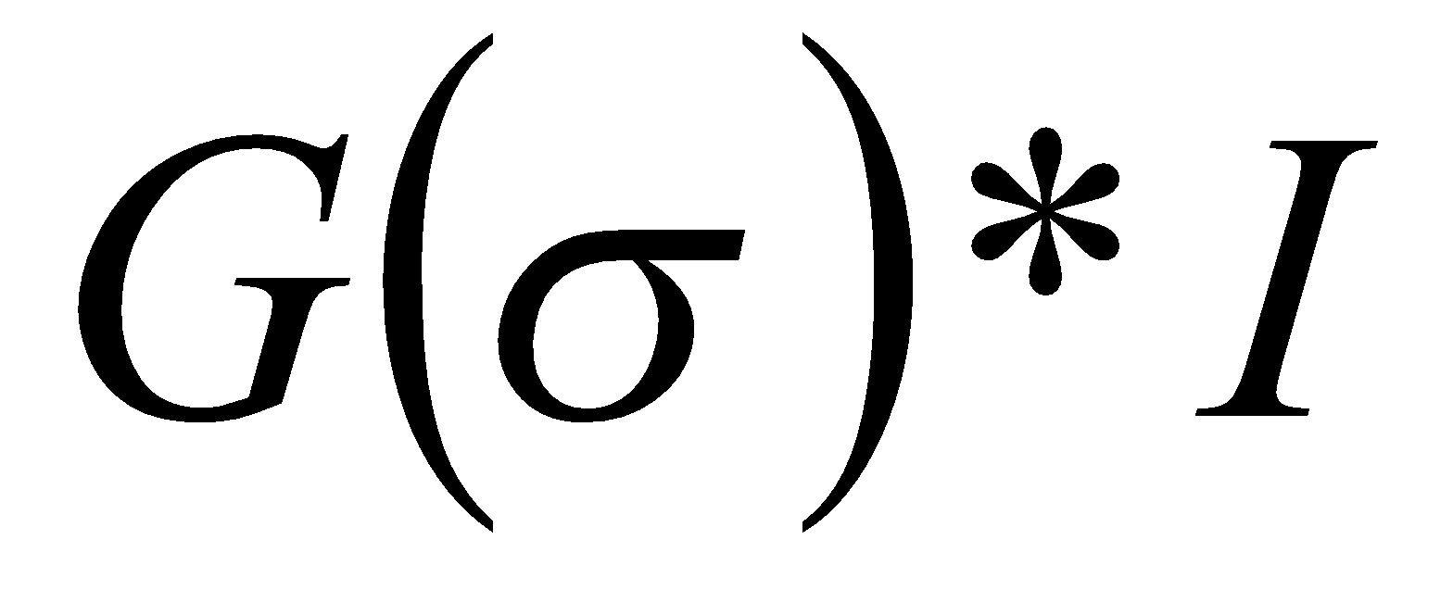
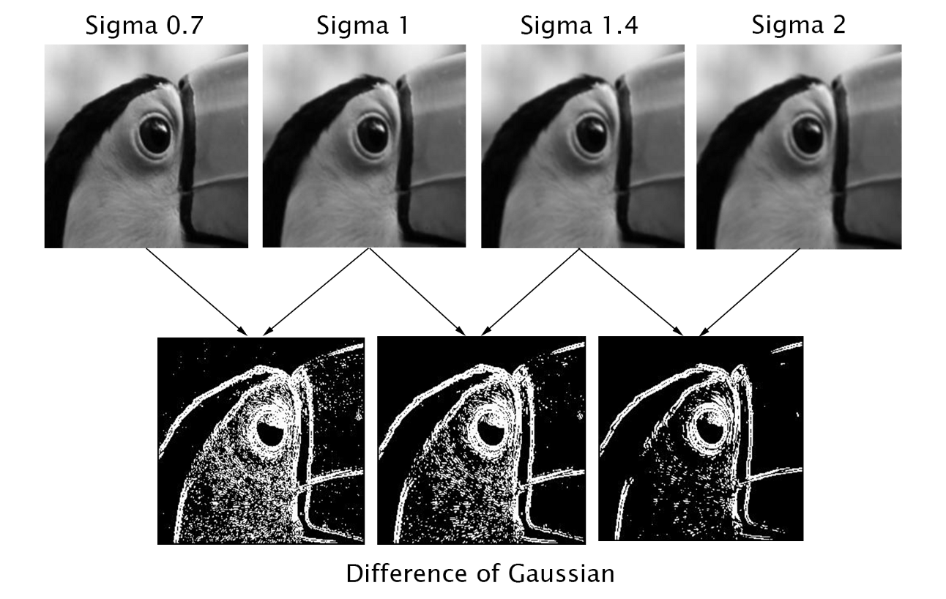
Difference-of-Gaussians
Notes:
Source https://medium.com/@vad710/cv-for-busy-devs-improving-features-df20c3aa5887

Slide 33
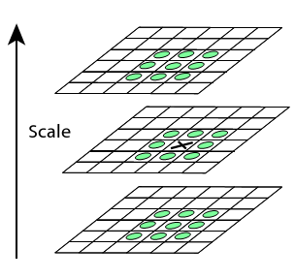
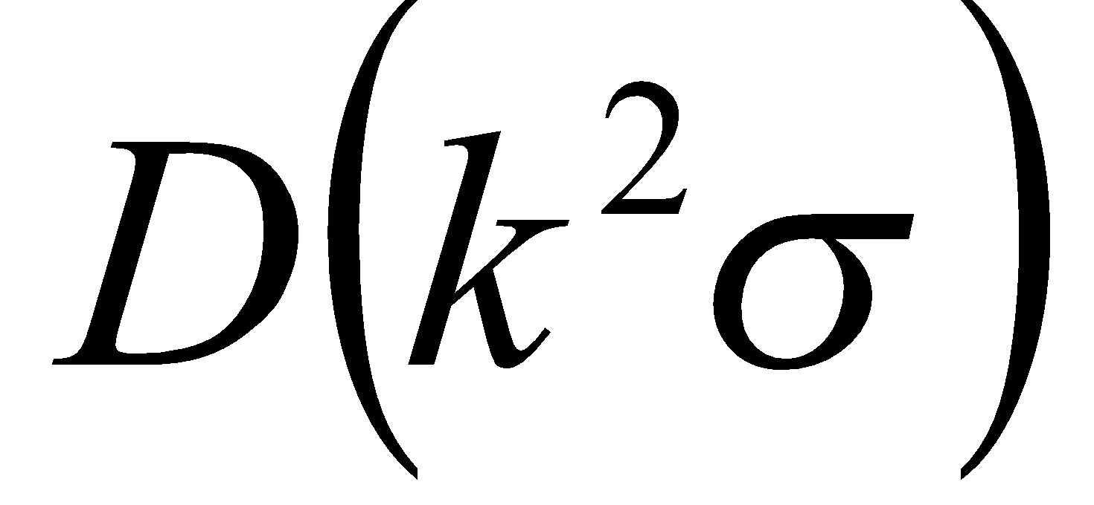
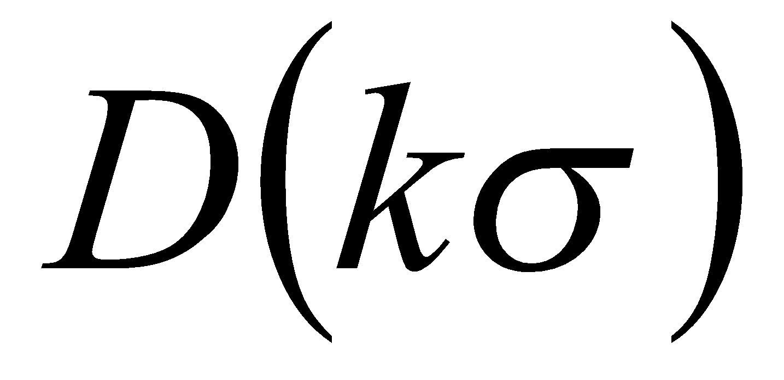
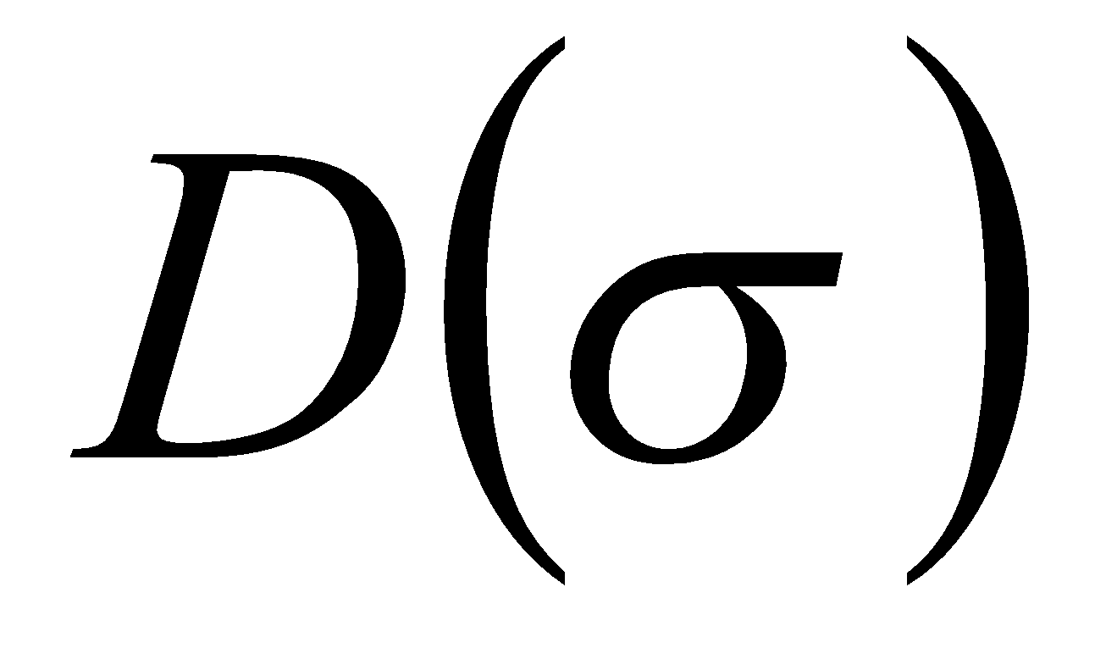
Scale-Space Extrema
Choose all extrema within 3x3x3 neighborhood.
X is selected if it is larger or smaller than all 26 neighbors
Keypoints are not detected in the lowermost and topmost scales. There simply aren't enough neighbours.
For better robustness SIFT interpolates this points for sub-pixel accuracy.

Slide 34
Scale Invariant Detection: Summary
Given: two images of the same scene with a large scale difference between them
Goal: find the same interest points independently in each image
Solution: search for maxima of suitable functions in scale and in space (over the image)
Methods:
SIFT [Lowe]: maximize Difference of Gaussians over scale and space
SURF: The same steps with different functions, faster than SIFT, sometimes worse in quality
And others, see a good comparison https://arxiv.org/pdf/1710.02726.pdf

Slide 35


Local Descriptors
We know how to detect points
Next question:
How to describe them for matching?
?
Point descriptor should be:
Invariant
Distinctive
Slide credit: Kristen Grauman

Slide 36
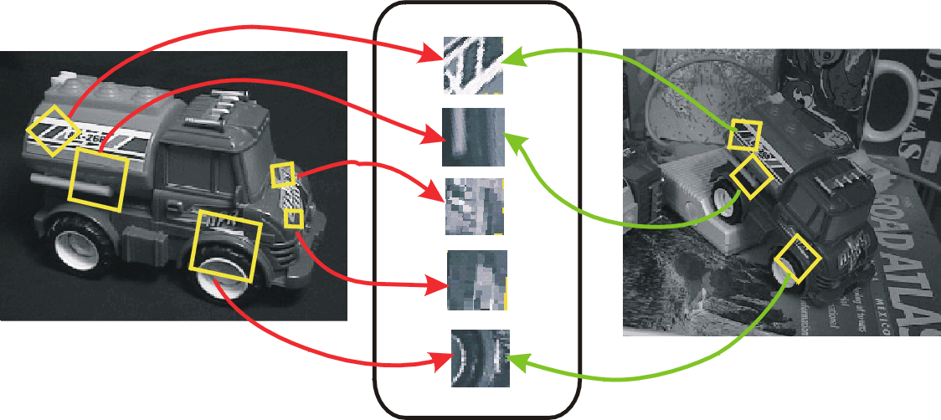
Invariant Local Features
Image content is transformed into local feature coordinates that are invariant to translation, rotation, scale, and other imaging parameters
Following slides credit: CVPR 2003 Tutorial on Recognition and Matching Based on Local Invariant Features David Lowe

Slide 37
Advantages of invariant local features
Locality: features are local, so robust to occlusion and clutter (no prior segmentation)
Distinctiveness: individual features can be matched to a large database of objects
Quantity: many features can be generated for even small objects
Efficiency: close to real-time performance
Extensibility: can easily be extended to wide range of differing feature types, with each adding robustness

Slide 38
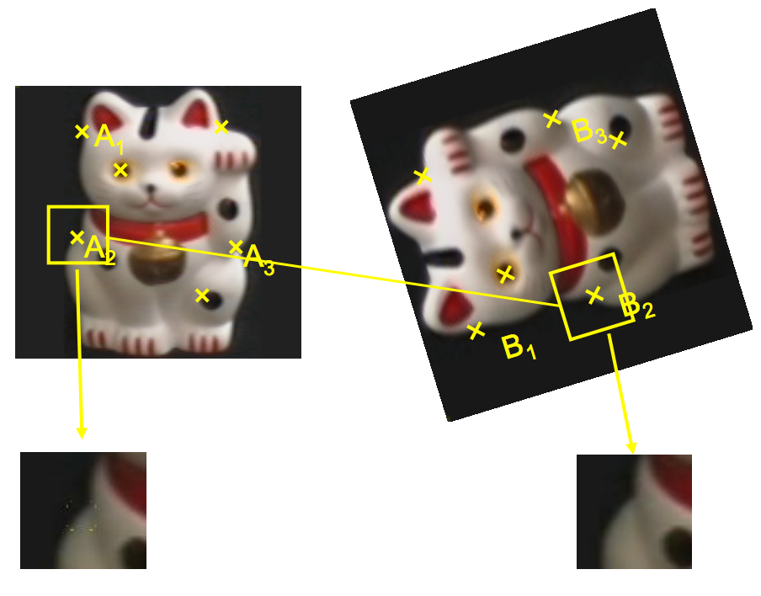
Becoming rotation invariant

Slide 39
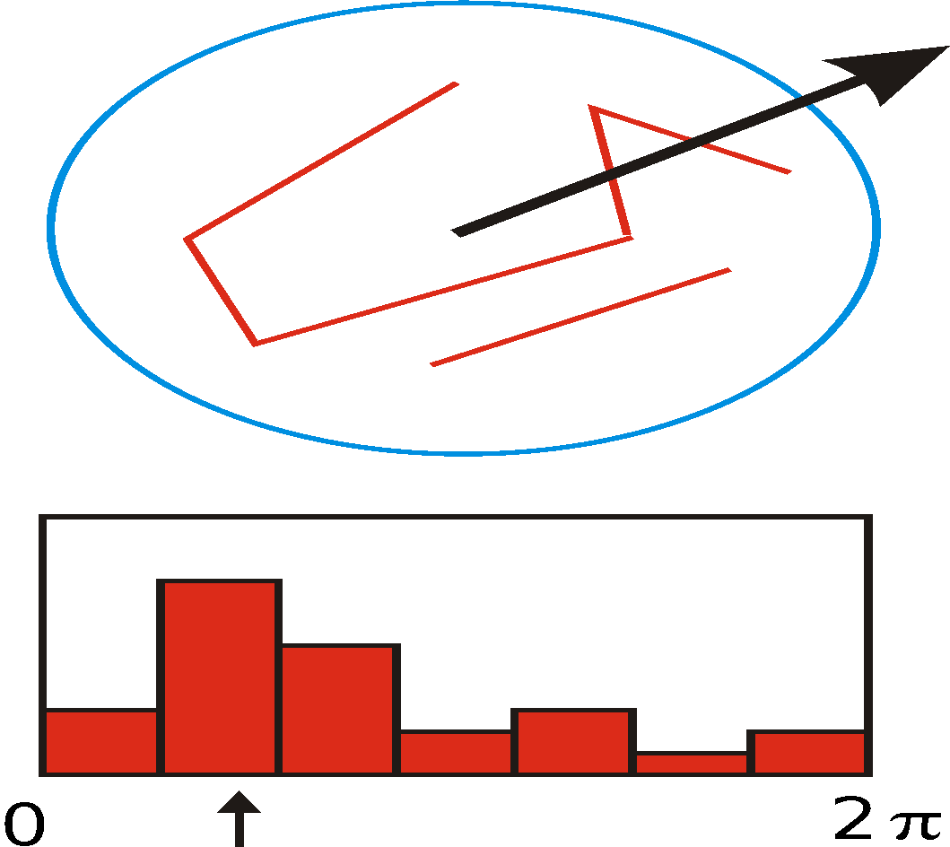
Becoming rotation invariant
We are given a keypoint and its scale from DoG
We will select a characteristic orientation for the keypoint (based on the most prominent gradient there; discussed next slide)
We will describe all features relative to this orientation
Causes features to be rotation invariant!
If the keypoint appears rotated in another image, the features will be the same, because they’re relative to the characteristic orientation

Slide 40
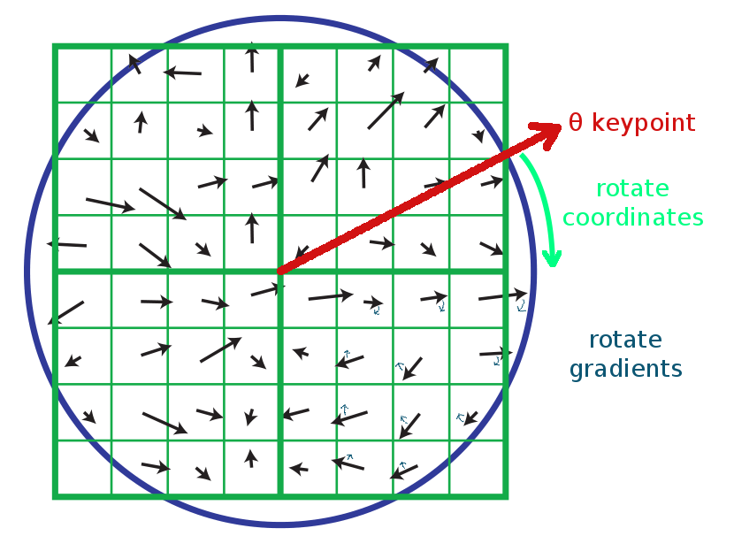
SIFT descriptor formation
Use the blurred image associated with the keypoint’s scale
Take image gradients over the keypoint neighborhood.
To become rotation invariant, rotate the gradient directions AND locations by (-keypoint orientation)
Now we’ve cancelled out rotation and have gradients expressed at locations relative to keypoint orientation θ
We could also have just rotated the whole image by -θ, but that would be slower.

Slide 41

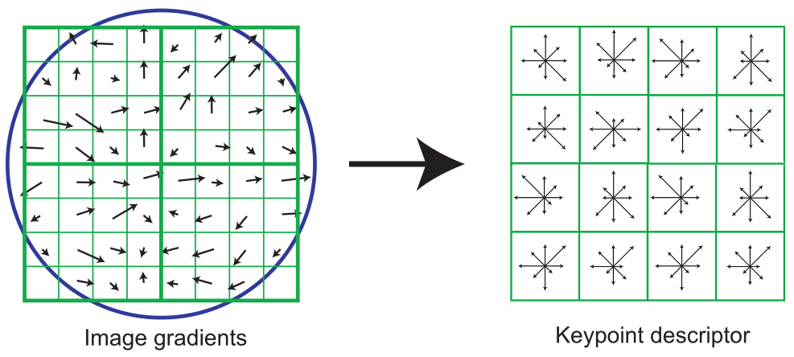
SIFT descriptor formation
0
2
π
Using precise gradient locations is fragile. We’d like to allow some “slop” in the image, and still produce a very similar descriptor
Create array of orientation histograms (a 4x4 array is shown)
Put the rotated gradients into their local orientation histograms
A gradients’s contribution is divided among the nearby histograms based on distance. If it’s halfway between two histogram locations, it gives a half contribution to both.
Also, scale down gradient contributions for gradients far from the center
The SIFT authors found that best results were with 8 orientation bins per histogram.

Slide 42
SIFT descriptor formation
Using precise gradient locations is fragile. We’d like to allow some “slop” in the image, and still produce a very similar descriptor
Create array of orientation histograms (a 4x4 array is shown)
Put the rotated gradients into their local orientation histograms
A gradients’s contribution is divided among the nearby histograms based on distance. If it’s halfway between two histogram locations, it gives a half contribution to both.
Also, scale down gradient contributions for gradients far from the center
The SIFT authors found that best results were with 8 orientation bins per histogram, and a 4x4 histogram array.

Slide 43
SIFT descriptor formation
8 orientation bins per histogram, and a 4x4 histogram array, yields 8 x 4x4 = 128 numbers.
So a SIFT descriptor is a length 128 vector, which is invariant to rotation (because we rotated the descriptor) and scale (because we worked with the scaled image from DoG)
We can compare each vector from image A to each vector from image B to find matching keypoints!
Euclidean “distance” between descriptor vectors gives a good measure of keypoint similarity

Slide 44
SIFT descriptor formation
Adding robustness to illumination changes:
Remember that the descriptor is made of gradients (differences between pixels), so it’s already invariant to changes in brightness (e.g. adding 10 to all image pixels yields the exact same descriptor)
A higher-contrast photo will increase the magnitude of gradients linearly. So, to correct for contrast changes, normalize the vector (scale to length 1.0)
Very large image gradients are usually from unreliable 3D illumination effects (glare, etc). So, to reduce their effect, clamp all values in the vector to be ≤ 0.2 (an experimentally tuned value). Then normalize the vector again.
Result is a vector which is fairly invariant to illumination changes.

Slide 45
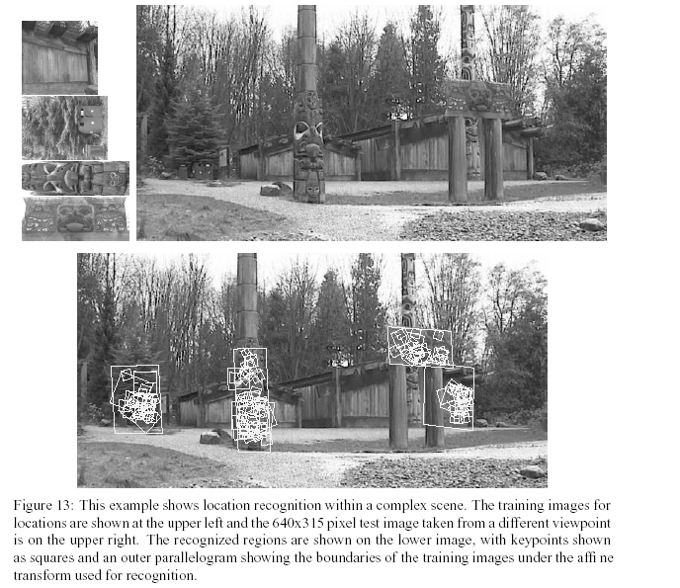
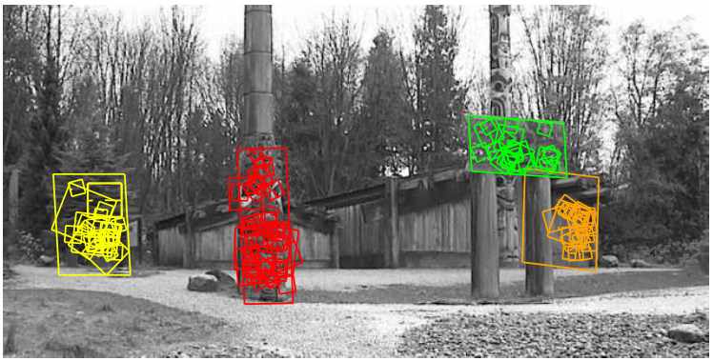

Slide 46
SIFT resources
an online step-by-step tutorial: https://aishack.in/tutorials/sift-scale-invariant-feature-transform-introduction/
Wikipedia:http://en.wikipedia.org/wiki/Scale-invariant_feature_transform

Slide 47
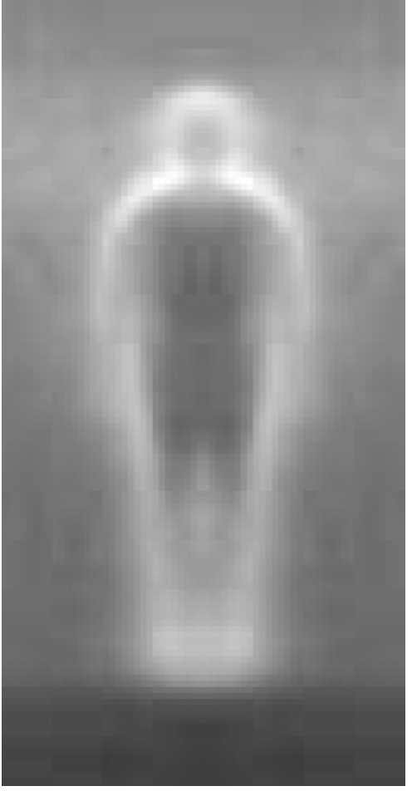
Histogram of Oriented Gradients
Local object appearance and shape can often be characterized rather well by the distribution of local intensity gradients or edge directions.

Slide 48
Difference between HoG and SIFT
HoG is usually used to describe entire images. SIFT is used for key point matching
SIFT histrograms are oriented towards the dominant gradient. HoG is not.
HoG gradients are normalized using neighborhood bins.
SIFT descriptors use varying scales to compute multiple descriptors.

Slide 49

Application: Image Stitching
Procedure:
Detect feature points in both images
Find corresponding pairs
Use these pairs to align the images
Slide credit: Darya Frolova, Denis Simakov

Slide 50
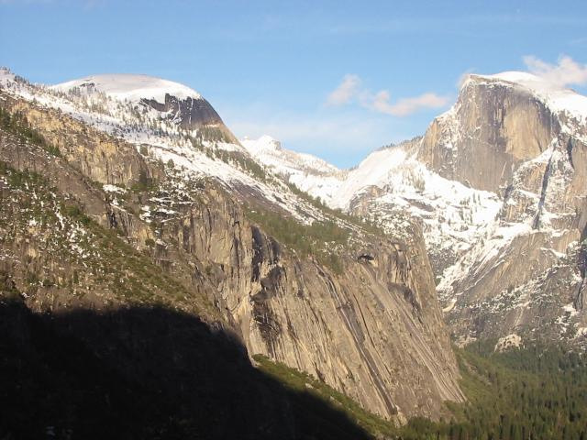
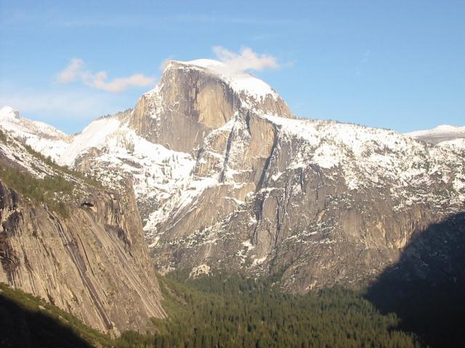
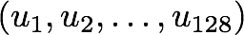
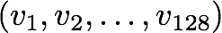
Main Flow
Detect key points
Build the SIFT descriptors
Match SIFT descriptors

Slide 51
Main Flow
Detect key points
Build the SIFT descriptors
Match SIFT descriptors
<- nearest neighbour search with euclidean distance. Matches are rejected if the ratio of the nearest neighbor distance to the second-nearest neighbor distance is greater than 0.8.

Slide 52
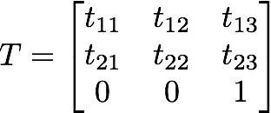
Main Flow
Detect key points
Build the SIFT descriptors
Match SIFT descriptors
Fitting the transformation with RANSAC

Slide 53

RANSAC
There are many outliers in keypoints matching
Solution:
Sample n random matches
Estimate from them transform parameters
Count number inliers
Choose best set of parameters based on 3.
Reestimate transformation on all the inliers

